Slide 1
DIGITAL PORTFOLIO
STUDENT NAME: KAVYA VARSINI S
REGISTER NO AND NMID: 2428B0323/C6733A2CF7A184F9C5D4F66495FA0629
DEPARTMENT: B.Sc COMPUTER SCIENCE WITH DATA ANALYTICS
COLLEGE:KPR COLLEGE OF ARTS SCIENCE AND RESEARCH
UNIVERSITY:BARATHIYAR UNIVERSITY

Slide 2
PROJECT TITLE Special Interests (AI, Data, etc.)

Slide 3


AGENDA
Problem Statement
Project Overview
End Users
Tools and Technologies
Portfolio design and Layout
Features and Functionality
Results and Screenshots
Conclusion
Github Link
3/21/2024 Annual Review

Slide 4

PROBLEM STATEMENT
In the current academic and professional landscape, students and professionals often have diverse special interests such as Artificial Intelligence, Data Analytics, Cybersecurity, and Web Development. However, traditional resumes and portfolios usually focus only on education and experience, leaving limited space to highlight these interests. This makes it difficult for recruiters, mentors, or collaborators to understand an individual’s true passion areas and future goals.
Therefore, there is a need for a dedicated “Special Interests” section in digital portfolios where learners can clearly showcase their interest domains, projects, and aspirations. This not only provides a better picture of their personality and career vision but also helps in connecting them with relevant opportunities and networks.

Slide 5

PROJECT OVERVIEW
The project “Special Interests (AI, Data, etc.)” focuses on creating a dedicated section in a digital portfolio that highlights an individual’s passion areas and domains of interest beyond formal education and certifications. Many learners today explore fields like Artificial Intelligence, Data Analytics, Cybersecurity, Cloud Computing, and Web Development, but often struggle to represent these interests in a structured manner within traditional resumes.
This portfolio section allows users to present their areas of curiosity, ongoing explorations, and related projects in a visually appealing format. It not only reflects the learner’s enthusiasm for emerging technologies but also provides recruiters, educators, and peers with deeper insights into their future aspirations. The design emphasizes clarity and professionalism, ensuring that interests are linked with skills, goals, and potential career paths.By including a “Special Interests” section, the portfolio becomes more personalized, engaging, and impactful, helping individuals stand out in academic, professional, and networking opportunities.

Slide 6

WHO ARE THE END USERS?
Students
To highlight their passion areas (e.g., AI, Data, Web Development) along with academic achievements.
Useful in placements, internships, and higher studies applications.
Job Seekers / Professionals
To showcase domains they are exploring or wish to specialize in.
Helps recruiters understand their career direction.
Recruiters / Employers
To evaluate not just current skills but also future potential and areas of interest of candidates.
Educators / Mentors
To guide learners better by knowing their preferred domains.
Encourages students to pursue projects and certifications aligned with interests.
Peers / Collaborators
To identify common interests, enabling collaboration on projects, research, or hackathons.
.

Slide 7

TOOLS AND TECHNIQUES
HTML5, CSS3, JavaScript – To build and style the “Special Interests” section with interactive effects.
VS Code – Development environment for coding and testing.
Git & GitHub – For version control and hosting the portfolio online.
Responsive Web Design (RWD) – Ensures the section adapts to different devices (mobile, tablet, desktop).
User-Centered Design – To keep the layout simple, clear, and recruiter-friendly.

Slide 8
POTFOLIO DESIGN AND LAYOUT
Header Section – Title “Special Interests” with a relevant icon or symbol.
List / Card View – Each interest (e.g., Artificial Intelligence, Data Analytics, Cybersecurity) displayed as a card or bullet list.
Short Descriptions – Each interest briefly explained with why it matters or how it relates to the learner’s career goals.
Icons / Graphics – Technology-related icons (like AI brain, database, cloud) to make the section visually appealing.
Responsive Design – Adjusts well to desktops, tablets, and mobile screens.
Consistent Theme – Professional fonts, matching colors, and uniform spacing to align with the rest of the portfolio.
8

Slide 9
FEATURES AND FUNCTIONALITY
Interest Highlighting – Displays key domains such as AI, Data Analytics, Web Development, etc.
Brief Descriptions – Each interest has a short note on its relevance or personal motivation.
Interactive Design – Hover effects or clickable cards for better engagement.
Icons / Visuals – Technology-related icons or graphics to make the section attractive.
Responsive Layout – Works smoothly on mobile, tablet, and desktop.
User-Friendly Interface – Clean, professional, and easy for recruiters or mentors to understand.

Slide 10

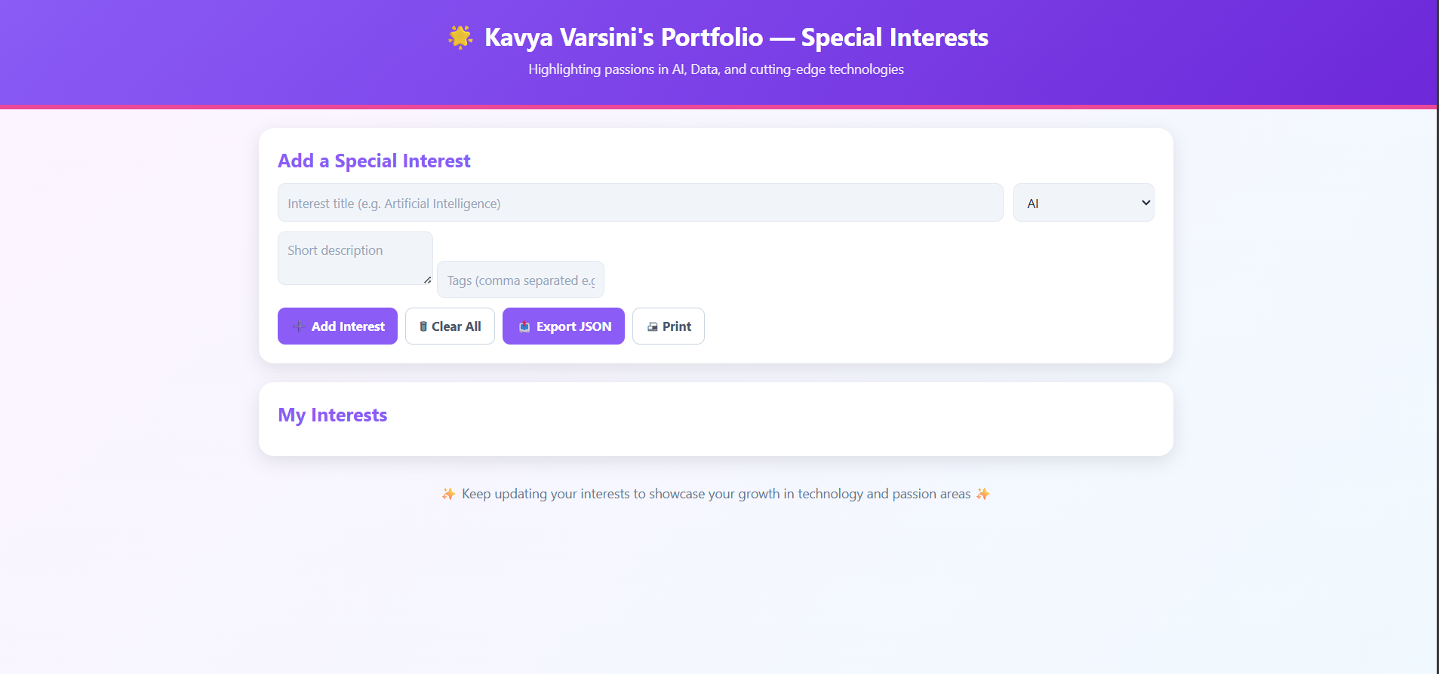
RESULTS AND SCREENSHOTS
RESULT :
The “Special Interests” section was successfully created to highlight key passion areas like AI, Data Analytics, and Cybersecurity. It is designed to be responsive, clear, and visually appealing, making it easy for recruiters and mentors to understand the learner’s future goals. This adds a personalized touch to the portfolio and helps individuals stand out.
3/21/2024 Annual Review
10

Slide 11
CONCLUSION
The project “Special Interests (AI, Data, etc.)” effectively demonstrates the importance of including personal passion areas in a digital portfolio. Unlike traditional resumes that mainly focus on academics and certifications, this section allows individuals to showcase their curiosity and enthusiasm in domains such as Artificial Intelligence, Data Analytics, Cybersecurity, and Web Development. By highlighting these interests, learners can present not only their current skills but also their future aspirations. The design of the section is responsive, visually appealing, and easy to navigate, ensuring accessibility on all devices. Features like icons, short descriptions, and interactive cards make the presentation more engaging and professional. This helps recruiters quickly understand the learner’s career direction and potential. Mentors can also use this information to provide better guidance, while peers can identify common interests to collaborate on projects and research. The section adds a personalized touch to the portfolio, making it more impactful during placements and networking opportunities. Overall, the project bridges the gap between what learners know today and what they aim to pursue in the future, giving them a stronger identity in the academic and professional world.
11

Slide 12
GITHUB LINK
https://kavyavarsini.github.io/kavya-portfolio/

